Slide 1
Comparing memory and meta-memory abilities between children with acquired brain injury and healthy peers
學生：張語軒
指導教授：柳永青

Slide 2
Introduction
Cognitive deficits are common among children with ABI and persist even when the child overcomes his or her physical disability (Hooft et al)
Deficits in attention and memory are the most common cognitive dysfunctions in ABI (Allen et al)

Slide 3
Deficits in the capacity to learn and remember new information reduce the child’s ability to acquire essential knowledge, which in turn influences quality of life from short- and long-term perspectives (Souza, Braga et al)
Poor immediate and delayed recall and reduced recognition memory for verbal and visual information (Allen et al)

Slide 4
Method
32 children and adolescents participated in the study
Age ranged from 8 to 19 years old

Slide 5
CMT-CH
The Contextual Memory Test for Children
The scores for the immediate and delayed recall and recognition are ranged between 0–18

Slide 6
Data analyses
Under prediction/estimation where their prediction or estimation were lower than actual performance
Over prediction/estimation where their prediction or estimation were higher than actual performance
No difference (a delta of less than 2) from actual performance.

Slide 7
Result
Memory abilities :
Children in the study group remembered significantly fewer items in the immediate and delayed recall subtests compared with children in the control group.

Slide 8
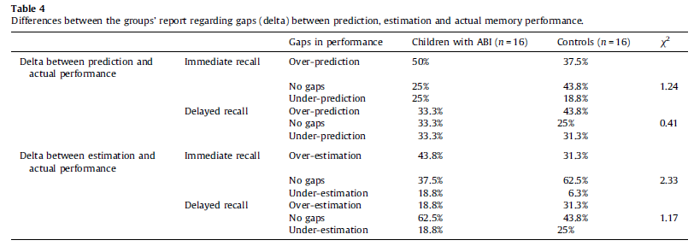
Self-awareness
The study group 68.8% reported that they have lower memory abilities than other children as compared with 0% of the controls
31.2% reported they had similar memory abilities to other children

Slide 9
Memory and meta-memory
self-prediction and actual performance was found only for the delayed recall in the study group (r = .52; p = .04)
self-estimation and actual performance were found for immediate recall and delayed recall in the study group (r = .73 and r = .83; p = .00, respectively)

Slide 10
Strategy use
Among the controls, the most prevalent strategy was the use of the context

Slide 11
Conclusion
The deficits in visual memory abilities of children with ABI found in this study, may be attributed to inefficient memorizing strategies used by these children

